Slide 1
Champions League Tracker
by Anything Group
(Alex Bilba, Deepika Kulkarni, Gil Solis, Peter Boldyrev)

Slide 2
Process and technologies
Enabling users to get most current game data and videos on the favorite championship.
Saving user’s time by providing a handy tool to see scores and videos for the Champions League;
Delivering game info to any location on any device;
Customer-first: data privacy is #1 priority;
No ads;

Slide 3
Process and technologies
Tasks and roles:
Alex Bilba: PM, HTML and CSS integration, owns GitHub repo
Deepika Kulkarni: Youtube API, integrates with Football API and HTML/CSS
Gil Solis: Materialize: CSS, integration with HTML
Peter Boldyrev: Football API, integration with HTML, presentation
Challenges | Successes
Deciding on the concept (API-driven vs concept driven); Free-tier API constraints: Re-focusing within the chosen concept and re-confirming user value; Deciding on the roles and creating the work breakdown structure; Assigning SOW and creating ROB meetings and schedule/milestones; Changing CSS Framework due to constraints; GitHub repo – master branch re-creation; | Idea to use 1 well-known API (YouTube) + 1 well-documented API (Football-data); Identifying the best CSS framework that fits the needs; Well communicated and documented work and updates; Defining the MVP - fast-fail approach to the MVP; Developing feature roadmap and prioritizing vs key concept;
HTML5
Materilize CSS ( https://materializecss.com/)
APIs:
Football API (https://www.football-data.org/)
Youtube API (https://developers.google.com/youtube/v3)

Slide 4
Football API walkthrough
Possible match status:
Played – Scheduled (T T)
Played – Not scheduled (T F)
Not Played – Scheduled (F T)
Not played – Not scheduled (F F)
Football API:
203 rows total;
Most recent matches are added from top to bottom (203rd row - most recent):
Statuses: scheduled and finished;
Functions:
displayData(); - displaying data about the match
displayModal(msg) - multi-purpose function displaying a modal when called
Played = T && Scheduled = T – played the first game and scheduled second game; displayData(); (date played, score, teams names, winner) displayModal(); (showing when the game is scheduled) | Played = F && Scheduled = T – Scheduled but not played yet displayModal(”These teams are scheduled to play”);
Played = T && Scheduled = F – played and no more games scheduled; displayData(); (date played, score, teams names, winner and stage) | Played = F && Scheduled = F – not played and not scheduled; displayModal(”These teams are not scheduled to play”);
User presses GO without selecting the team: displayModal(“Please select teams”);

Slide 5

YouTube API walkthrough
YouTube API:
Uses data that was created in Football API call to build a search string.
Search string passed to the YouTube API to search for the relevant results;
String consists of:
Team 1 name, Team 2 name, date formatted, league name;
Appends search result to the carousel in the HTML;
String consists of:
Team 1 name, Team 2 name, date formatted;

Slide 6
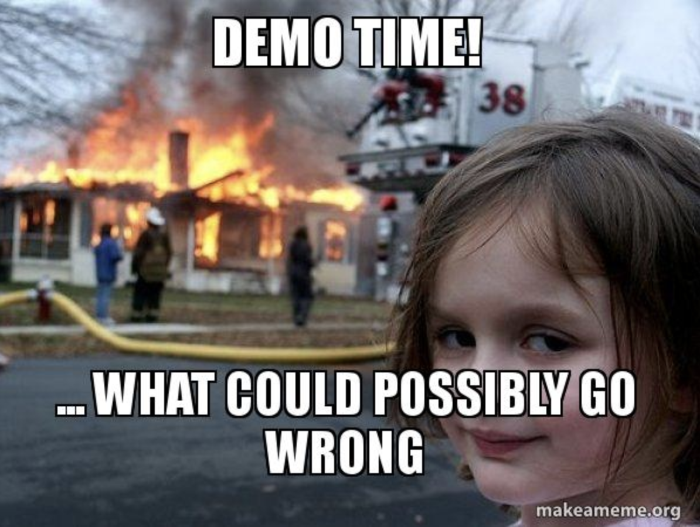
Demo

Slide 7
Future roadmap
Choose from 12 different competitions from the free-tier API subscription;
Saving your favorite team to the local storage;
Displaying league standings and highlighting your favorite team;
Twilio API integration for score SMS alerting;
Implementing weather data for the city the match is played;
Introducing premium features for subscription:
Selecting from 100+ competitions
Ability to pick the dates to review historical data for the seasons and more
Expanding the concept to other sports using different APIs;

Slide 8

Questions?

